Slide 1


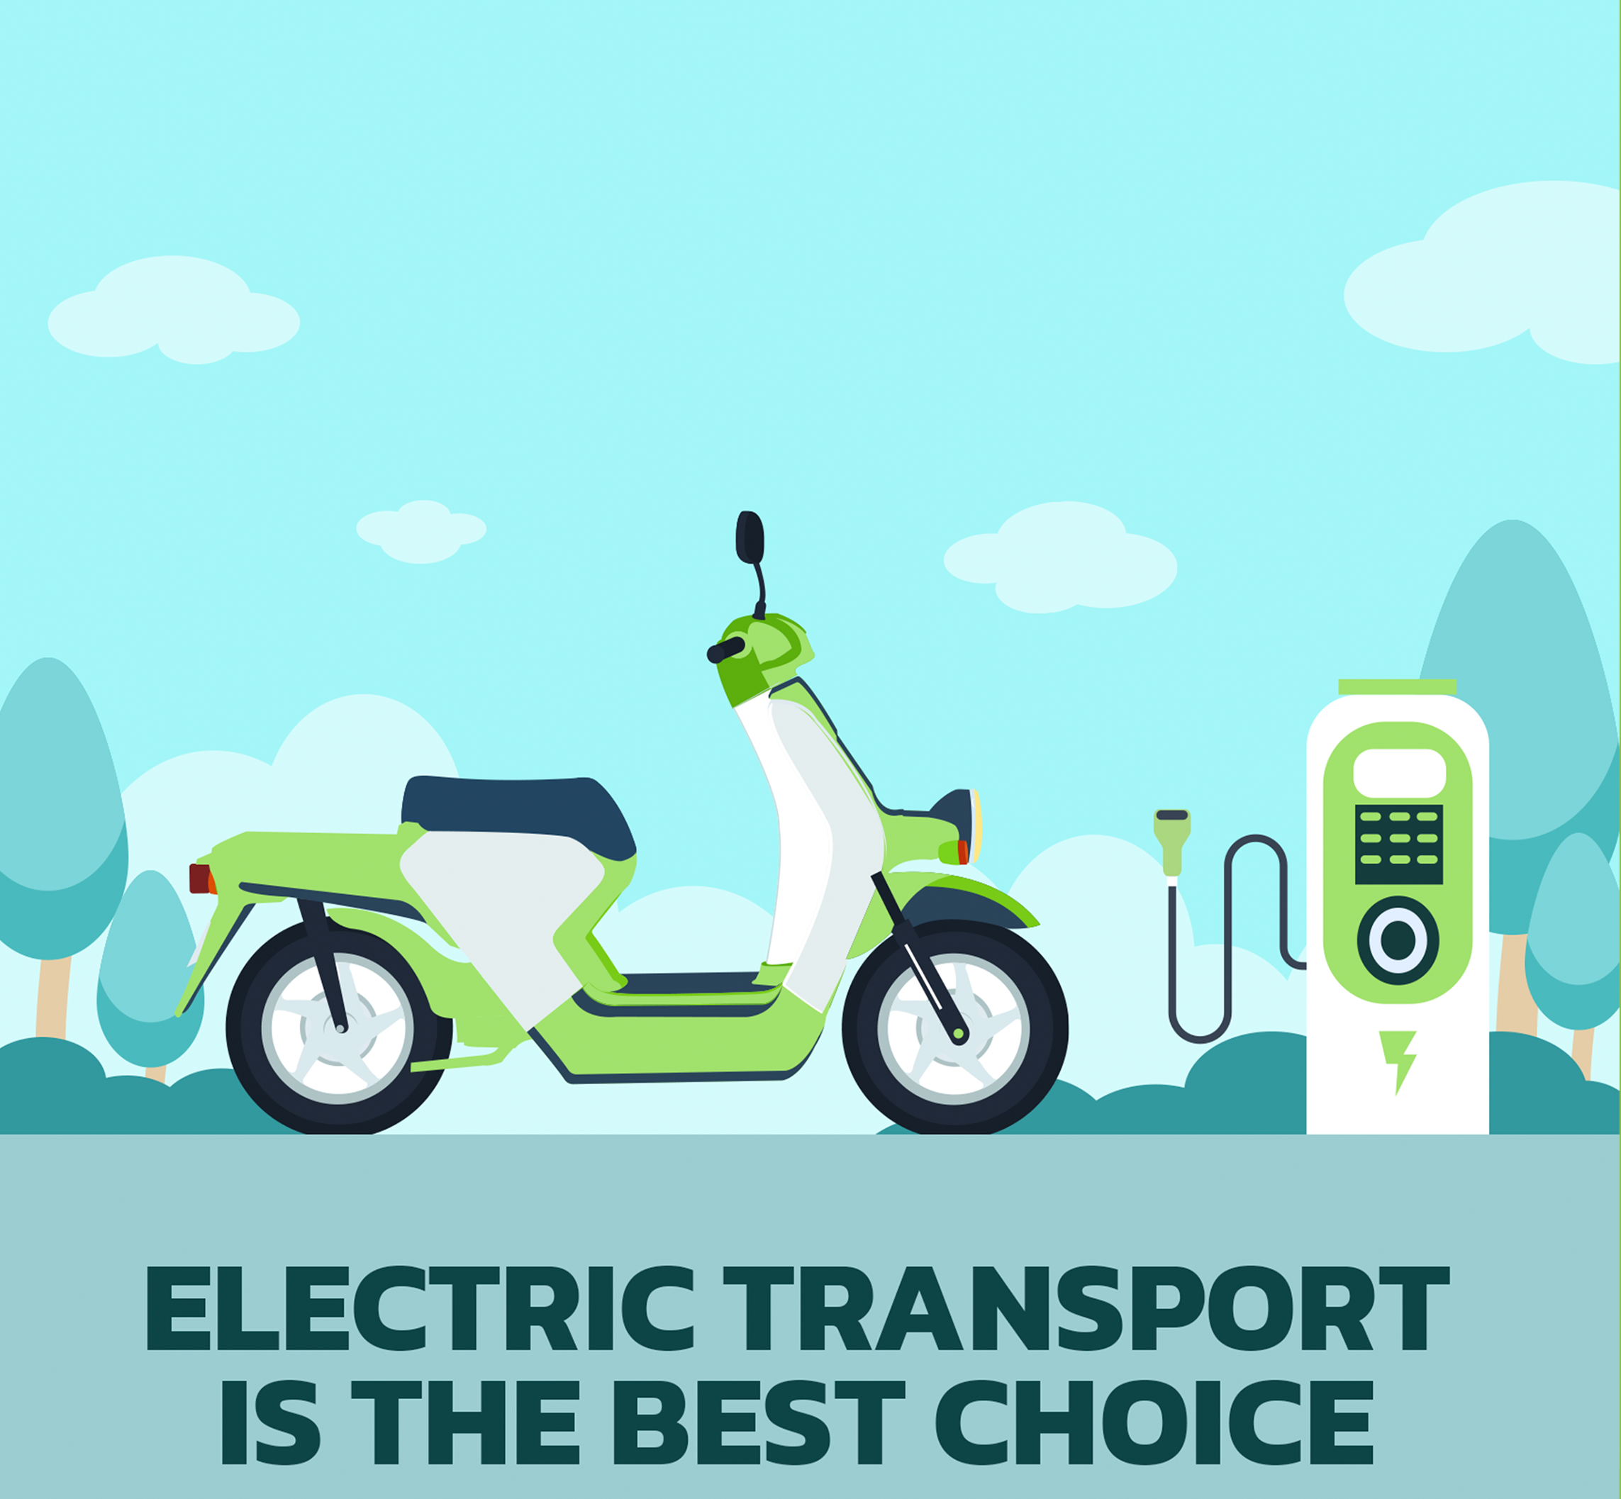

Electric Vehicle Analysis in India
Gunjan Revar

Slide 2
Electric Vehicle Analysis
1. About Company
Agenda
2. Problem Statement
3. Objective
4. About Data
5. Dashboard
6. Insights
7. Recommendations

Slide 3

About the Company
AtliQ Motors, a leading automotive company based in the USA, has established itself as a key player in the electric vehicle (EV) industry. Over the past five years, it has captured a 25% market share in the electric and hybrid vehicle segment across North America.

Slide 4

Problem Statement
As part of their growth strategy, AtliQ Motors aimed to introduce their bestselling models in India, where their current market share is under 2%. To ensure a well-informed approach, Bruce Haryali, head of AtliQ Motors India, decided to conduct an in-depth analysis of the existing EV and hybrid vehicle market in the country.

Slide 5

Objective
The objective is to perform a detailed market study of existing EV/Hybrid market in India. This will guide AtliQ Motors in making informed decisions as they plan to expand and increase their market share in the Indian EV sector.

Slide 6
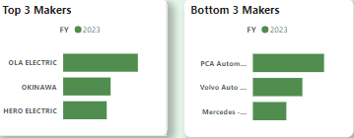
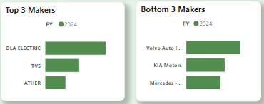
List the top 3 and bottom 3 makers for the fiscal years 2023 and 2024 in terms of the number of 2-wheelers sold.
Ola Electric leads in 2-Wheeler category in FY 2023 & 2024.

Slide 7
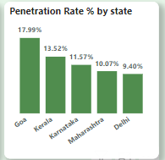
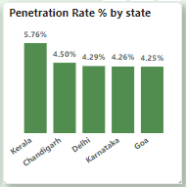
Identify the top 5 states with the highest penetration rate in 2-wheeler and 4-wheeler EV sales in FY 2024.
PR for 2-Wheelers
PR for 4-Wheelers
Goa ranked 1st in the 2-wheelers category, whereas ranked in 5th in the 4-wheelers category.

Slide 8
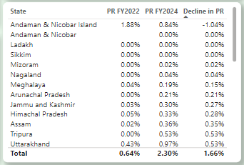
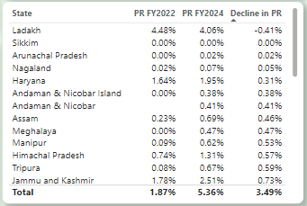
List the states with negative penetration (decline) in EV sales from 2022 to 2024?
Ladakh experienced a negative PR in 2-wheelers.
Andaman & Nicobar experienced a negative PR in 4-wheelers.

Slide 9
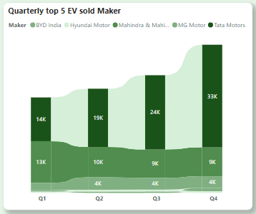
What are the quarterly trends based on sales volume for the top 5 EV makers (4-wheelers) from 2022 to 2024?
Tata motors is leader in 4-wheelers category from Q1 2022 to Q4 2024.
BYD started strong in Q1 but saw a slight dip Q2 & Q3. Then BYD experienced a sudden raise in Q4.

Slide 10
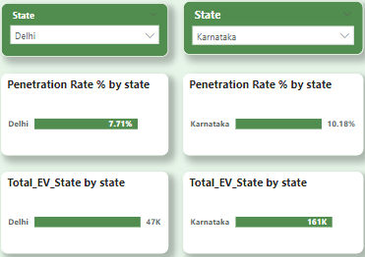
How do the EV sales and penetration rates in Delhi compare to Karnataka for 2024?
Karnataka holds higher PR of 10.18% compared to Delhi’s 7.71%.

Slide 11
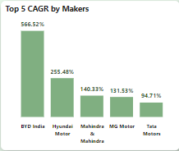
List down the compounded annual growth rate (CAGR) for the top 5 makers from 2022 to 2024.
Top 5 makers are BYD India, Hyundai Motor, M&M, MG Motor & Tata Motors.

Slide 12
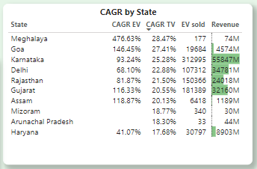
List down the top 10 states that had the highest compounded annual growth rate (CAGR) from 2022 to 2024 in total vehicles sold.
All states shown significant growth in total vehicles sold from 2022-2024.
Meghalaya leading at CAGR of 28.47% followed by Goa.

Slide 13
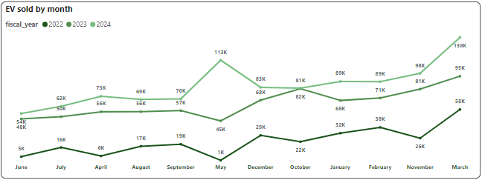
What are the peak and low season months for EV sales based on the data from 2022 to 2024?
March led with the Highest EV sales from 2022- 2024.
June & July are low seasoned months , May also saw low sales in 2022 & 2023 but experienced a growth in2024.

Slide 14
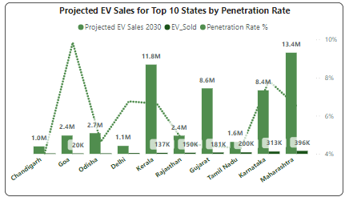
What is the projected number of EV sales (including 2-wheelers and 4- wheelers) for the top 10 states by penetration rate in 2030, based on the compounded annual growth rate (CAGR) from previous years?
Maharashtra is estimated to lead in 2030 EV sales with 13.4M.
Although Goa and Delhi have strong PR compared to other states.

Slide 15
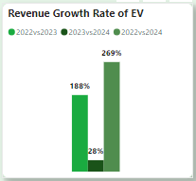
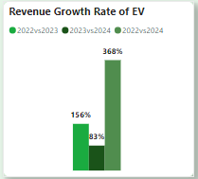
Estimate the revenue growth rate of 4-wheeler and 2-wheelers EVs in India for 2022 vs 2024 and 2023 vs 2024, assuming an average unit price.
2-Wheelers
4-Wheelers
Revenue growth for 22vs24 is 269% while for 23vs24 is 28% for 2-wheelers.
Revenue growth for 22vs24 is 368% while for 23vs24 is 83% for 4-wheelers.
4-wheelers are expanding at a faster pace compared to 2-wheelers.

Slide 16
Primary reasons for customers choosing 4-wheeler EVs in 2023 and 2024
Lower Operating Costs : EVs are recognized for their lower operating cost compared to ICE vehicles. This includes savings on fuel and reduced maintenance expenses.
Government Incentives and Policies : Subsidies, tax benefits, and policies such as India's FAME II scheme have made EVs more accessible by reducing upfront costs and supporting charging infrastructure development
Environmental concerns : Concern over air pollution in Indian cities drives a public shift from ICE vehicles to EVs.

Slide 17
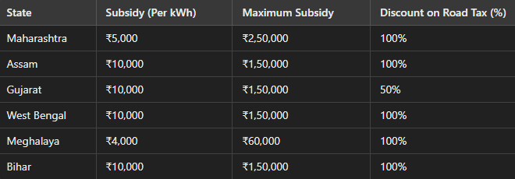
How do government incentives and subsidies impact the adoption rates of 2-wheelers and 4-wheelers? Which states in India provided most subsidies?
Data Source : TATA AIG State wise Report

Slide 18
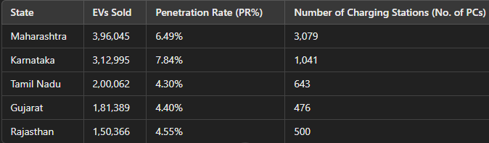
How does the availability of charging stations infrastructure correlate with the EV sales and penetration rates in the top 5 states?
States with a higher number of charging stations tend to have better EV sales and higher penetration rates. This suggests that accessible charging infrastructure is critical for encouraging EV adoption.

Slide 19
Which state of India is ideal to start the manufacturing unit?
1. Maharashtra
Maharashtra leads in EV sales and has a robust charging infrastructure with 3,079 public charging stations.
The state offers attractive subsidies for EV manufacturers and buyers under its EV Policy, including incentives for setting up EV manufacturing plants.
Strong demand for EVs and supporting industries
2. Gujarat
Offers the highest subsidies for EVs under its policy and has a growing ecosystem for EV adoption.
Strategic location with excellent ports and road infrastructure for logistics.
Lower operational costs compared to other states.
If the focus is on immediate market demand and infrastructure, Maharashtra is the ideal state. For R&D and innovation, Karnataka offers a strong tech ecosystem. For cost-efficiency and export opportunities, Tamil Nadu and Gujarat are attractive choices.

Slide 20
Top 3 recommendations for AtliQ Motors.
Focus on high-growth states with strong EV adoption potential and favourable CAGR trends.
Highlight and aggressively market best-selling vehicle categories to boost brand recognition.
Invest in long-term R&D and infrastructure to secure a dominant market share and prepare for future growth.

